Slide 1
Do Vision-Language Pretrained Models Learn Primitive Concepts?
22/06/15
AIV1 Sato
https://arxiv.org/abs/2203.17271
(Under review)

Slide 2
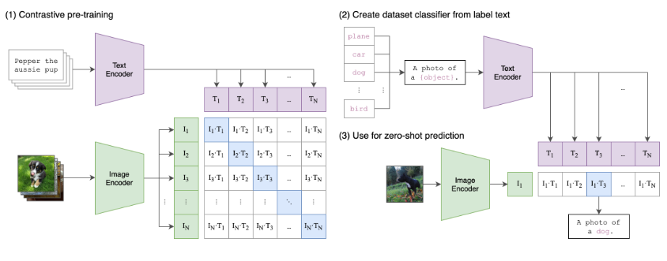
Vision and Language Models
Connecting visual concepts and natural language
Trained by huge image-caption dataset (i.e. 400 million pairs)
One of famous VL model: CLIP[1]
Powerful zero-shot transfer for various task
Have the potential to encode “commonsense knowledge”・・・？
More detail
Inoue-san’s presentation
(2021-06-21)
[1] https://openai.com/blog/clip/

Slide 3
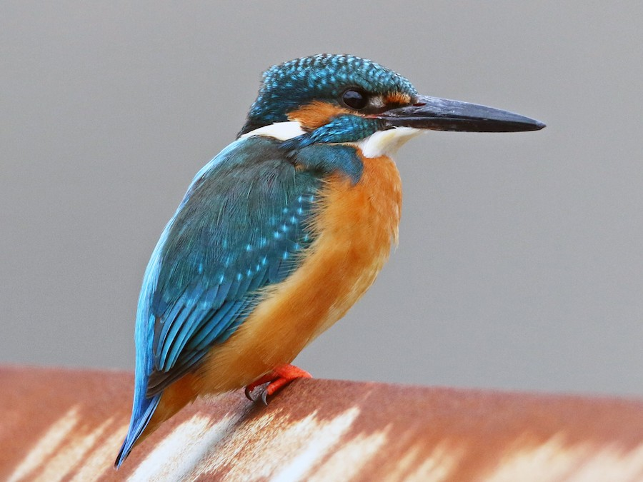
Primitive Concepts
Primitive Concepts: lower-level concept that humans naturally use to characterize complex concepts
i.e. “bohemian kingfisher”
Wing color – blue
Body color – orange
Beak shape - sharp
If VL models learned primitive concepts well:
Provide greater interpretability of VL models
VL model can be used a primitive concept extractor
⇒ we can construct another zero-shot classifier by specifying how a concept can be derived from primitives
Question: In practice, is the VL model able to learn Primitive Concepts? And is it capable of extracting Primitive Concepts?
red
sphere
Apple
fruit

Slide 4
Contribution of this paper
Propose a Computational framework to measure quantitatively how well a VL model has learned primitive concepts
Two indicators (i) Usefulness: the extracted primitives are effective in distinguishing things or not (ii) Interpretability: How clearly can the primitive be extracted?
Evaluated against three different VL models
CLIP, ViLT, ALBEF
CLIP is best, but...
Usefulness ： better than conventional primitive extoractors, but accuracy is not high
Interpretability ： almost nothing
Conclusion: there is still a lot of work to be done.

Slide 5
Menu
Background
Framework
Experiment

Slide 6


Framework Concept (i)
Assume that the primitive concepts are composable, and there exists a true derivation for any composite concept q, given an expressive set of candidate primitive concepts Cp.
Given a set of paired primitive concept activations e along with composite concept labels, can we learn a derivation model H that correctly maps the primitive concepts into the composite concepts, as achieved by the true derivation?
If H is linear classifier:
This framework indirectly measure the quality of learned primitive concepts under the following conditions
With dataset given the true correspondence between primitives from images and corresponding composite concepts e_gt: true primitive concept activations q_gt: true composite concepts
We can reliably learned
where
w: weights
e_i in e: corresponds to how likely a concept p_i presents (p_i ∈ Cp)

Slide 7

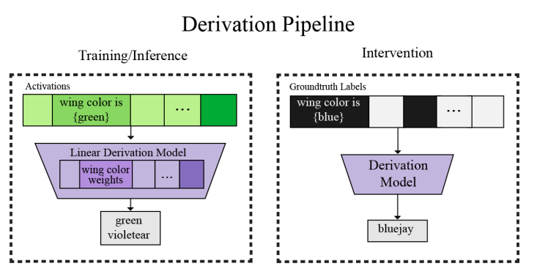
Framework Concept (ii)
Calculate the following steps
Define of two indicators
(i) Quantifying usefulness
( (e_pred) itself
(ii) Quantifying interpretability
Train (with ground truth)
Zero-shot test (including unseen composite concept)
真の対応関係
Hgtを作る
e_gt
q_gt
Get accuracy of , given e_gt(test)
pretrained
VL-modelから 抽出したe_pred
からHpredを作る
Train (with e_pred from pretrainVL model)
Zero-shot test (including unseen composite concept)
e_pred
q_gt
Get accuracy of (e_pred)
e_predが完璧じゃなくとも， test精度さえ高ければいい
e
H
q
e_predが完璧(抽出したprimitiveがはっきり0-1で分かれており正確)ならば， e_gtをH_predに与えたときにH_gtと同じ挙動をするはずだ
Input e_gt

Slide 8
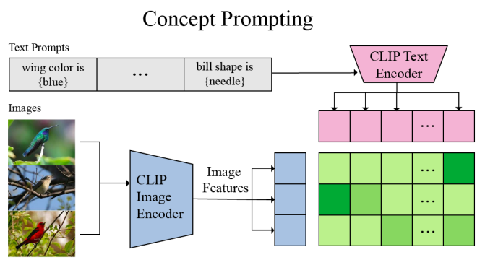
How to get e_pred
Concept Prompting
extracts the concept activations from a pretrained VL model based on the score function score(image, text)
For a primitive concept p, we fit it into a template sentence t(p) (for example, “a photo of [concept]”)
A concept representation can be computed with the score function e_p = s(x, t(p))
repeat the process for all primitive concepts to obtain the predicted primitive concept activations e_pred = [e1, ..., eN ].
Score(image,text)

Slide 9
Menu
Background
Framework
Experiment

Slide 10
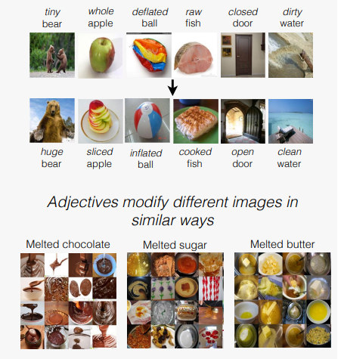
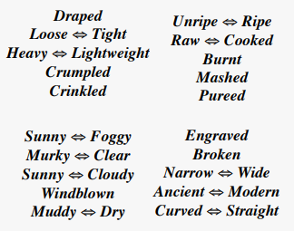
Experiments
In the paper, authors have experimented with experiments of zero-shot and few-shot setting, but today I only introduce zero-shot experiment.
Dataset:
MIT-States: 53K images of 115 attributes and 245 objects
Train: 30K images of 1262 attribute-object composition
Val: 10k images of 300 seen and 300 unseen composition
Test: 13k images of 400 seen and unseen composition (correct unseen composition number is 700)
Metrics
(i) Unseen-Seen Area Under the Curve(AUC)
(ii) Best accuracy on data samples of seen composition (best seen)
(iii) Best accuracy on data samples of unseen composition (best unseen)
(iv) Best harmonic mean (best HM)
These are to mitigate models’ bias on seen composition

Slide 11
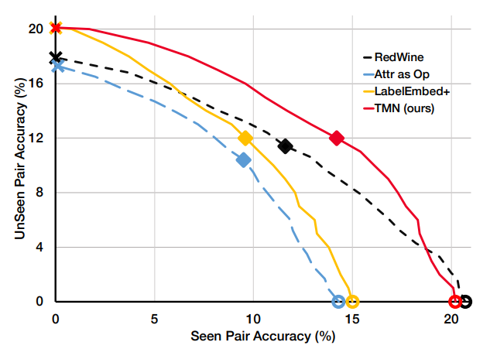
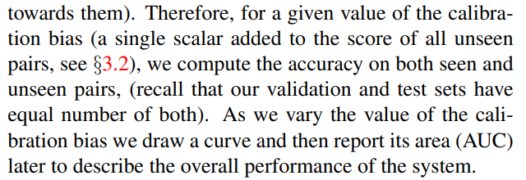
Samples of Unseen-seen area curve
https://arxiv.org/pdf/1905.05908.pdf

Slide 12
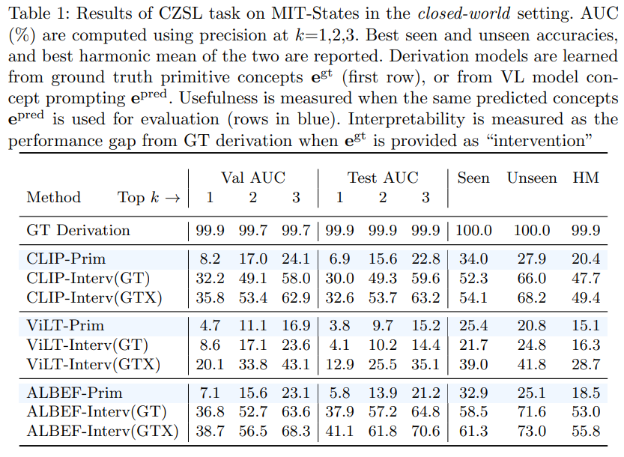
Results
Usefulness: blue background
Interpretability: with Interv(GT) or (GTX)

Slide 13
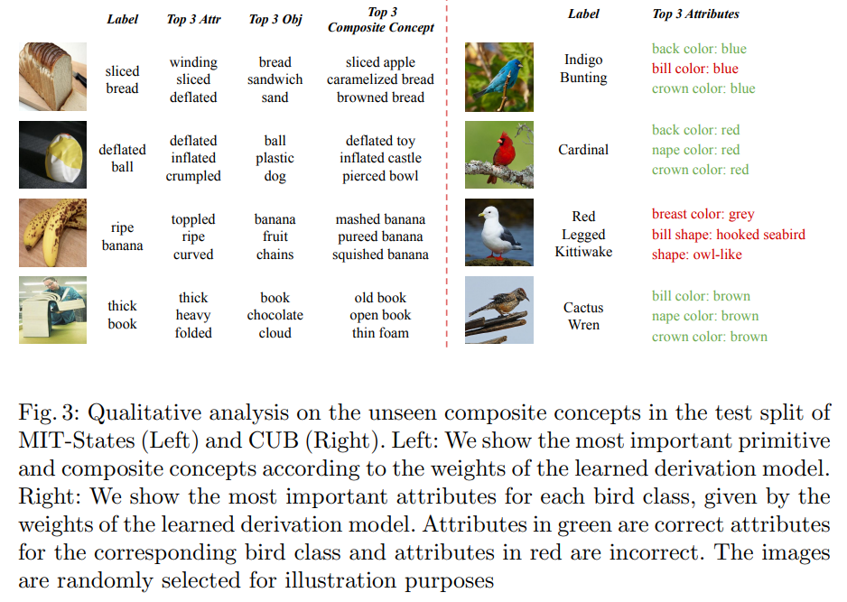
Qualitative Analysis of Derivations
物体の精度はよいが，属性を間違えがち

Slide 14
Conclusion
Propose a Computational framework to measure quantitatively how well a VL model has learned primitive concepts
Evaluated against three different VL models
CLIP is best, but...
Usefulness ： better than conventional primitive extoractors, but accuracy is not high
Interpretability ： almost nothing
コードとモデルの公開待ち
得意な概念，苦手な概念があるのか，均等に間違うのかすらわからない

Slide 15
END

Slide 16
Attributes in MIT-States
dry | wet | muddy | damp
dull | shiny
empty | full | filled | cluttered
engraved
eroded
fallen | standing
filled | empty
foggy | sunny
folded
frayed
fresh | wilted | moldy
frozen | thawed
full | empty
grimy | clean
heavy | lightweight
huge | tiny
inflated | deflated
large | small
lightweight | heavy
loose | tight
mashed
melted
modern | ancient
moldy | fresh
molten
mossy
muddy | dry
murky | clear
narrow | wide
new | old | worn
old | new | young
open | closed
painted | unpainted
peeled
pierced
pressed
pureed
raw | cooked
ripe | unripe
ripped
rough | smooth
ruffled
runny | viscous
rusty
scratched
sharp | blunt
shattered
shiny | dull
short | tall
sliced
small | large
smooth | rough
spilled
splintered
squished
standing | fallen
steaming
straight | winding | bent | curved
sunny | foggy | cloudy
tall | short
thawed | frozen
thick | thin
thin | thick
tight | loose
tiny | huge
toppled | upright
torn
unpainted | painted
unripe | ripe
upright | toppled
verdant | barren
viscous | runny
weathered
wet | dry
whipped
wide | narrow
wilted | fresh
windblown
winding | straight
worn | new
wrinkled
young | old
ancient | modern
barren | verdant
bent | straight
blunt | sharp
bright | dark
broken
browned
brushed
burnt
caramelized
chipped
clean | grimy | dirty
clear | murky
closed | open
cloudy | sunny
cluttered | empty
coiled
cooked | raw
cored
cracked
creased
crinkled
crumpled
crushed
curved | straight
cut
damp | dry
dark | bright
deflated | inflated
dented
diced
dirty | clean
draped

